Slide 1
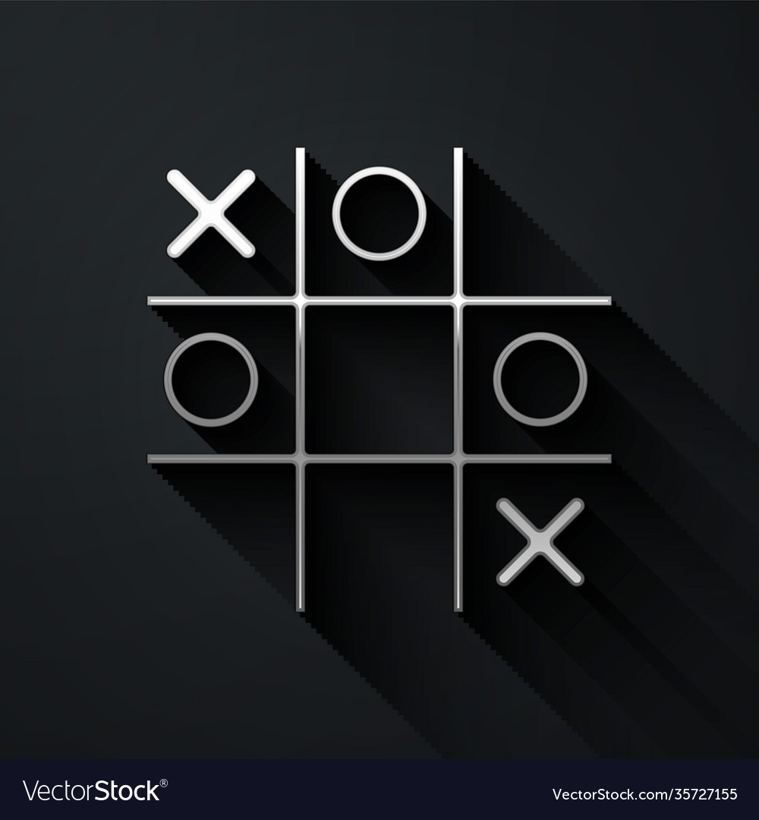
GAME DEVELOPMENT USING
PYTHON
BY:
RAJENDHAR:1602-22-735-089
NITHIN:1602-22-735-083
SHASHI KANTH:1602-22-735-109

Slide 2
Introduction
What is Tic Tac Toe?
Tic Tac Toe, also known as "Noughts and Crosses," is a classic two-player game that has been enjoyed by people of all ages for generations. It's a simple yet engaging game that requires strategic thinking.
How is it Played?
The game is played on a 3x3 grid.
Two players take turns marking a space with their symbol (X or O).
The objective is to form a line of three of your symbols horizontally, vertically, or diagonally.

Slide 3
Why Play Tic Tac Toe?
Quick Gameplay: Each game is short, making it ideal for a quick round of entertainment.
Strategic Thinking: While easy to grasp, Tic Tac Toe offers strategic depth as players aim to outmaneuver each other.
Timeless Appeal
Tic Tac Toe is not just a game; it's a timeless experience that brings joy and challenges players to think ahead. Whether played on paper, a physical board, or implemented in code, Tic Tac Toe remains a classic that transcends generations. Let's explore a Python implementation of this beloved game using the Pygame library!

Slide 4
ABSTRACT
The "Game Development using Python" project represents an immersive journey into the world of video game creation, catering to both beginners and intermediate programmers. This project aims to empower individuals with the skills and knowledge necessary to design, develop, and deploy interactive games using Python as the primary programming language
The Tic-Tac-Toe Game Project in Python is a classic implementation of the popular two-player board game, often referred to as "X and O" or "Noughts and Crosses." This project aims to provide an engaging and interactive platform for users to play the game, enhancing their understanding of Python programming and game development concepts

Slide 5
Technologies used:
1. Pygame:
• Pygame is a set of Python modules designed for writing video games. It includes computer graphics and sound libraries.
In this case, it is used to create the graphical user interface for the Tic
Tac Toe game.
• Usage in the Program: Pygame is used for initializing the game window, handling user input, drawing the game grid, symbols, and
managing the game loop.
2. sys:
• The sys module provides access to some variables used or maintained by the Python interpreter, and functions that interact strongly with the interpreter.
• Usage in the Program: The sys module is used here to exit the program when the user closes the game window.

Slide 6
3. random:
• The random module provides functions for generating random numbers.
• Usage in the Program: The random module is used to implement the basic logic of the computer move in one-player mode.
4.Main Menu:
• The program includes a main menu that allows the player to choose between a one-player game against the computer or a two-players game.
• Usage in the Program: The main_menu function uses the Pygame
library to create a simple menu where the user can click to choose
the game mode

Slide 7
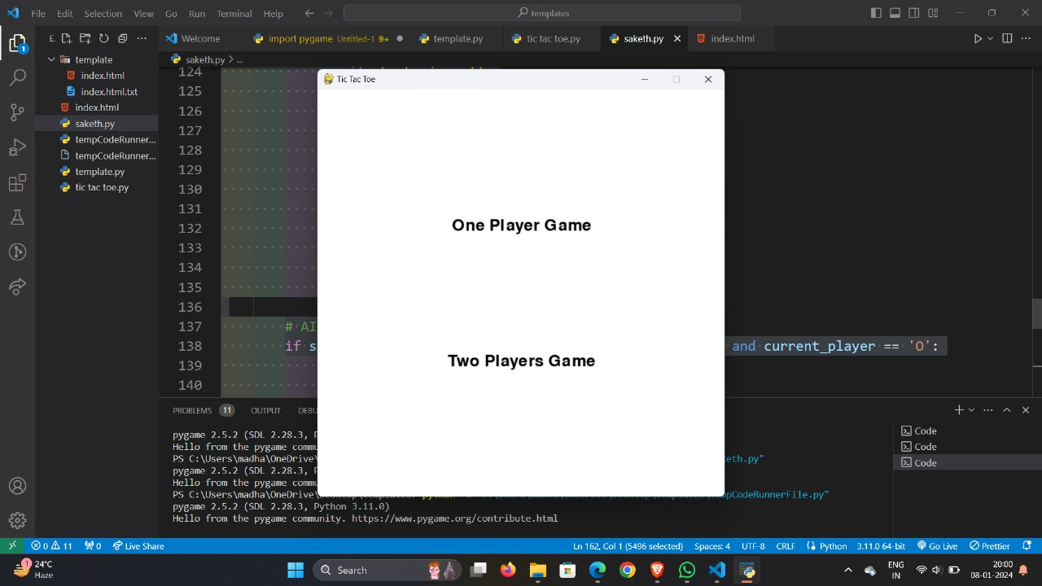
Screenshots of Execution:

Slide 8
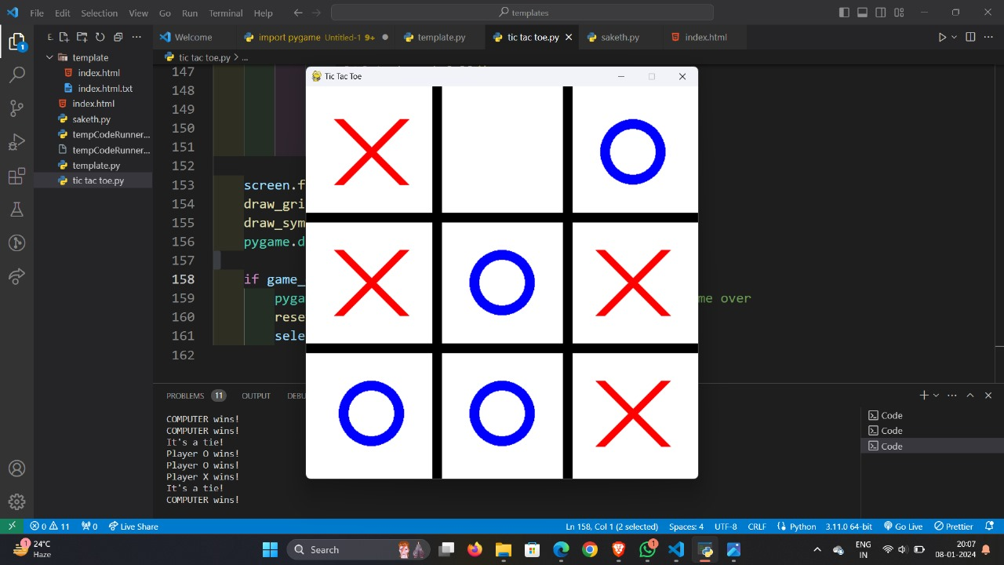

Slide 9
CONCLUSION:
In conclusion, the development of the Tic Tac Toe mini project using Python and Pygame has been an instructive journey. It reinforced fundamental programming concepts, demonstrated the basics of game development, and provided opportunities for problem-solving.
Key takeaways include the customization of the game's visual elements, the incorporation of user interaction for player moves, and the introduction of a simple AI opponent. The project serves as a foundation for understanding game loops, user input handling, and the creation of visually engaging interfaces.

Slide 10
Future enhancements could focus on improving the user interface, implementing advanced AI algorithms, incorporating multiplayer options, and adding features for scorekeeping and statistics.
Overall, this mini project provides a solid starting point for further exploration into game development and serves as a valuable learning experience in programming and application design

Slide 11
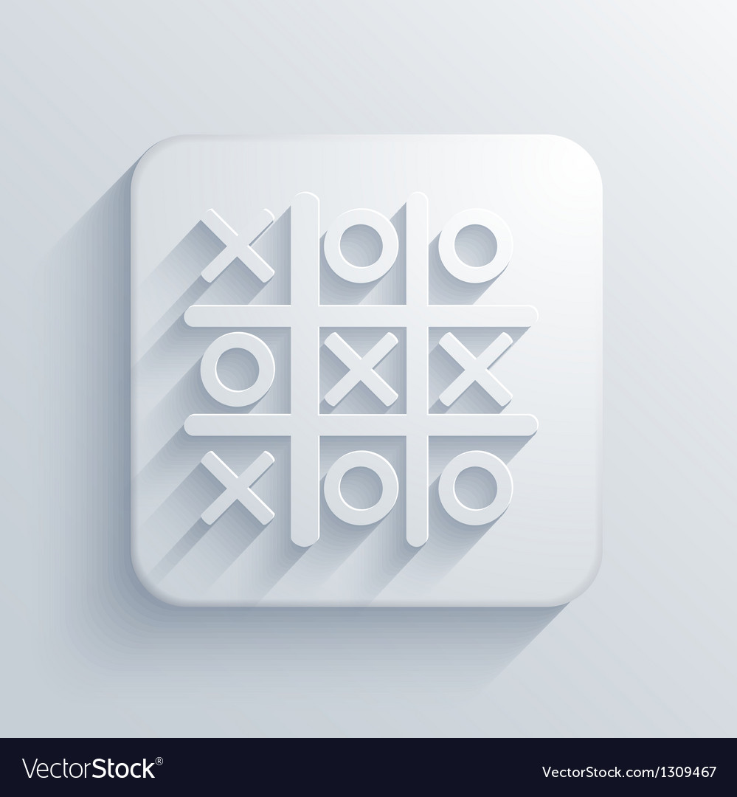
REFERENCE:
1.GOOGLE
2.CHATGPT
3.HACKERRANK
4.YOUTUBE

Slide 12
THANK YOU

